Slide 1
BV 202 - SharePoint 2016
What’s New and Why should I Upgrade?

Slide 2
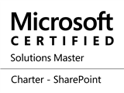
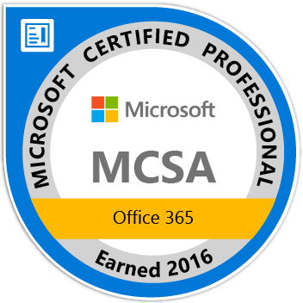
Paul Papanek Stork
Principal Architect
Blue Chip Consulting Group
http://www.bluechip-llc.com
Author
Developer’s Guide to WSS 3.0
MOSS 2007 Best Practices
MCTS: WSS 3.0 Configuration Study Guide (70-631)
SharePoint 2010 Development for Office 365
Microsoft Community Contributor
Technet Forums
MSDN Forums
Yammer Groups
Contact Information
Email: Paul.Stork@bluechip-llc.com
Blog: http://dontPaPanic.com/blog
Twitter: @PStork
Notes:
Principal SharePoint Architect for BlueChip Consulting Group
http://www.bluechip-llc.com
SharePoint MVP for 9 years
SharePoint Microsoft Certified Master
Author
Developer’s Guide to WSS 3.0
MOSS 2007 Best Practices
MCTS: WSS 3.0 Configuration Study Guide (70-631)
SharePoint 2010 Development for Office 365
Contact Information
Email: Paul.Stork@bluechip-llc.com
Blog: http://dontPaPanic.com/blog
Twitter: @PStork

Slide 3
Agenda
What’s new in SharePoint Server 2016
What’s been removed or deprecated
What new features have been added
Quick look at a few of the new and improved features
Expanded Collaboration Experience
Improved Infrastructure and Performance
Better Hybrid Support
Upgrade Challenges
How will these changes improve your business?
Notes:
SharePoint 2016 is the newest version in the On-Premises SharePoint story. But what’s the business value for going through another upgrade cycle? In this talk we’ll outline the new features that SharePoint 2016 adds to the mix and how it lays the groundwork for additional features going forward. We’ll discuss 2016’s roots in the cloud, how it changes the underlying service model for deployment, and what role it plays in the ever increasing number of hybrid deployments.

Slide 4
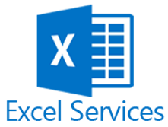
What’s gone from SharePoint 2016
SharePoint Foundation
SharePoint Foundation 2013 remains available for use.
Standalone Install mode
SQL Express no longer supported.
ForeFront Identity Manager client (FIM)
Microsoft Identity Manager 2016 (MIM) is one method suggested to manage identity within SharePoint.
Excel Services in SharePoint
Excel Services functionality is now part of Excel Online in the new Office Online Server .
Notes:
Duet Enterprise for Microsoft SharePoint isn't available with SharePoint Server 2016
Duet Enterprise for Microsoft SharePoint and SAP cannot be deployed with SharePoint Server 2016.
SharePoint Server 2016 doesn't have any Duet components so it will not install.
If you want to deploy Duet Enterprise for Microsoft SharePoint you must use SharePoint Server 2013 Enterprise Edition.
SharePoint Foundation
SharePoint Foundation 2013 remains available for use.
Previous releases of SharePoint Server included SharePoint Foundation.
Standalone Install mode
SharePoint Server 2016 doesn't support the standalone install option, so it is no longer available in the setup program.
Use the Single Server Farm MinRole during installation to create this type of deployment.
ForeFront Identity Manager client (FIM)
Earlier versions of SharePoint used ForeFront Identity Manager client (FIM) to synchronize between Active Directory and SharePoint.
SharePoint Server 2016 no longer uses FIM as the synchronization client. The default process is Active Directory Import.
You can also use any synchronization tool such as Microsoft Identity Manager 2016 (MIM 2016), or any third-party tool.
According to Microsoft, tools to help you deploy and configure Microsoft Identity Manager 2016 to work with SharePoint Server 2016 for identity synchronization are coming soon.
MIM 2016 is poised to become a replacement for FIM.
A new and existing user identity and access management application.
Excel Services in SharePoint
Excel Services and its associated business intelligence capabilities are no longer hosted on SharePoint Server.
Excel Services functionality is now part of Excel Online in Office Online Server
This is the next version of Office Web Apps Server, and SharePoint users can use the services from there.
If you currently use Excel Services in SharePoint 2013 and upgrade to SharePoint Server 2016 you must also deploy Office Online Server with Excel Online to ensure Excel Services functionality remains available.
The following Excel Services functionality has been deprecated:
Trusted data providers
Trusted file locations
Trusted data connection libraries
Unattended service account
Excel Services Windows PowerShell cmdlets
Opening of Excel workbooks from SharePoint Central Administration site
The following Excel Services functionality requires Excel Online in Office Online Server:
Viewing and editing Excel workbooks in a browser (with or without the Data Model)
Excel Web Access web part for SharePoint
ODC file support (no longer requires Data Connection Libraries)
Programmability features such as JavaScript OM, User Defined Function Assemblies, SOAP and REST protocol support
SharePoint BI capabilities
SharePoint Server 2016 requires updated versions that will ship later this year.
The SQL Server 2014 Power Pivot and Power View add-ins for SharePoint Server 2016 cannot be deployed or used in SharePoint Server 2016.
To deploy these add-ins you need to upgrade to SQL Server 2016 CTP 3.1. For more information, see New and improved features in SharePoint Server 2016 and Known Issues in SharePoint Server 2016 Release Candidate.
The following business intelligence features are available with SharePoint Server 2016 when you download SQL Server 2016 CTP 3.1:
Power Pivot Gallery
Scheduled Data Refresh
Using another workbook's Data Model as a data source
Power View reports (standalone or embedded in Excel workbooks)
Power View Subscriptions and Report Alerting Power Pivot Management Dashboard
BISM Link support
Tags and Notes
The Tags and Notes feature is deprecated in SharePoint Server 2016.
Users can no longer create new tags and notes or access existing ones. However, an administrator can archive all existing tags and notes by using PowerShell (Export-SPTagsAndNotesData cmdlet.)
Not sure what you as an admin will do with those exported tags and notes but Microsoft says you can export them via PowerShell.
Stsadm.exe
We recommend that you use Windows PowerShell when you perform command-line administrative tasks. The Stsadm command-line tool has been deprecated, but it is included to support compatibility with previous product versions.

Slide 5
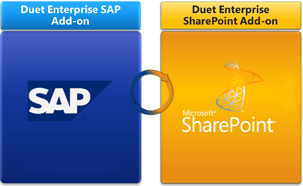
What’s gone from SharePoint 2016a
SharePoint BI capabilities
SQL Server 2016 CTP 3.1 required.
Tags and Notes
Stsadm.exe
The Stsadm command-line tool is still deprecated, but it is still being shipped to support compatibility with previous product versions.
Duet Enterprise for Microsoft SharePoint
Notes:
Duet Enterprise for Microsoft SharePoint isn't available with SharePoint Server 2016
Duet Enterprise for Microsoft SharePoint and SAP cannot be deployed with SharePoint Server 2016.
SharePoint Server 2016 doesn't have any Duet components so it will not install.
If you want to deploy Duet Enterprise for Microsoft SharePoint you must use SharePoint Server 2013 Enterprise Edition.
SharePoint Foundation
SharePoint Foundation 2013 remains available for use.
Previous releases of SharePoint Server included SharePoint Foundation.
Standalone Install mode
SharePoint Server 2016 doesn't support the standalone install option, so it is no longer available in the setup program.
Use the Single Server Farm MinRole during installation to create this type of deployment.
ForeFront Identity Manager client (FIM)
Earlier versions of SharePoint used ForeFront Identity Manager client (FIM) to synchronize between Active Directory and SharePoint.
SharePoint Server 2016 no longer uses FIM as the synchronization client. The default process is Active Directory Import.
You can also use any synchronization tool such as Microsoft Identity Manager 2016 (MIM 2016), or any third-party tool.
According to Microsoft, tools to help you deploy and configure Microsoft Identity Manager 2016 to work with SharePoint Server 2016 for identity synchronization are coming soon.
MIM 2016 is poised to become a replacement for FIM.
A new and existing user identity and access management application.
Excel Services in SharePoint
Excel Services and its associated business intelligence capabilities are no longer hosted on SharePoint Server.
Excel Services functionality is now part of Excel Online in Office Online Server
This is the next version of Office Web Apps Server, and SharePoint users can use the services from there.
If you currently use Excel Services in SharePoint 2013 and upgrade to SharePoint Server 2016 you must also deploy Office Online Server with Excel Online to ensure Excel Services functionality remains available.
The following Excel Services functionality has been deprecated:
Trusted data providers
Trusted file locations
Trusted data connection libraries
Unattended service account
Excel Services Windows PowerShell cmdlets
Opening of Excel workbooks from SharePoint Central Administration site
The following Excel Services functionality requires Excel Online in Office Online Server:
Viewing and editing Excel workbooks in a browser (with or without the Data Model)
Excel Web Access web part for SharePoint
ODC file support (no longer requires Data Connection Libraries)
Programmability features such as JavaScript OM, User Defined Function Assemblies, SOAP and REST protocol support
SharePoint BI capabilities
SharePoint Server 2016 requires updated versions that will ship later this year.
The SQL Server 2014 Power Pivot and Power View add-ins for SharePoint Server 2016 cannot be deployed or used in SharePoint Server 2016.
To deploy these add-ins you need to upgrade to SQL Server 2016 CTP 3.1. For more information, see New and improved features in SharePoint Server 2016 and Known Issues in SharePoint Server 2016 Release Candidate.
The following business intelligence features are available with SharePoint Server 2016 when you download SQL Server 2016 CTP 3.1:
Power Pivot Gallery
Scheduled Data Refresh
Using another workbook's Data Model as a data source
Power View reports (standalone or embedded in Excel workbooks)
Power View Subscriptions and Report Alerting Power Pivot Management Dashboard
BISM Link support
Tags and Notes
The Tags and Notes feature is deprecated in SharePoint Server 2016.
Users can no longer create new tags and notes or access existing ones. However, an administrator can archive all existing tags and notes by using PowerShell (Export-SPTagsAndNotesData cmdlet.)
Not sure what you as an admin will do with those exported tags and notes but Microsoft says you can export them via PowerShell.
Stsadm.exe
We recommend that you use Windows PowerShell when you perform command-line administrative tasks. The Stsadm command-line tool has been deprecated, but it is included to support compatibility with previous product versions.

Slide 6
Why upgrade – Collaboration
Improved Collaboration Experience
Enhanced Mobile Experience
Open Document Format (ODF) support
Durable Links
Improved App Launcher UI

Slide 7
Why upgrade - Infrastructure
Improved Infrastructure and Performance
Zero Downtime Patching
Increased Capacities
Faster Site Collection Creation
MinRole Management

Slide 8
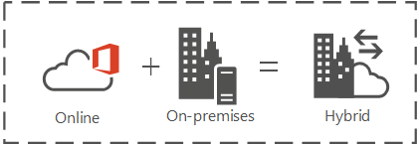
Why Upgrade? - hybrid
New Compliance Center and Data Loss Protection
Hybrid Support
Hybrid Sites
Hybrid OneDrive
Cloud Hybrid Search

Slide 9
Why Upgrade? - Challenges
Challenges
Durable Links requires Office Online Server
Full Trust Code
Still Supported
Could cause Upgrade issues
Need more servers
SharePoint 2013 – Minimal HA environment 7 Servers
SharePoint 2016 – Minimal HA environment 11 Servers

Slide 10
Expanded Collaboration Experience

Slide 11
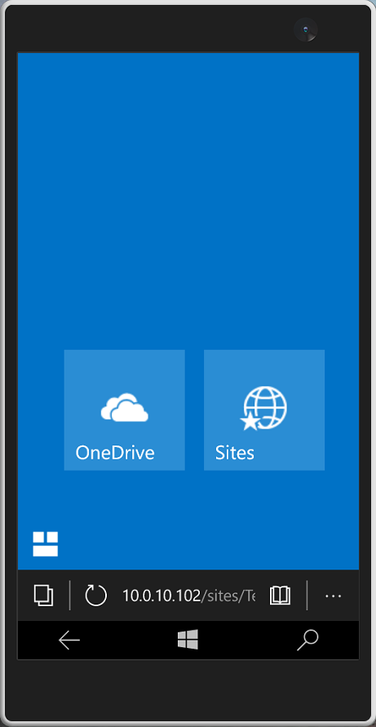
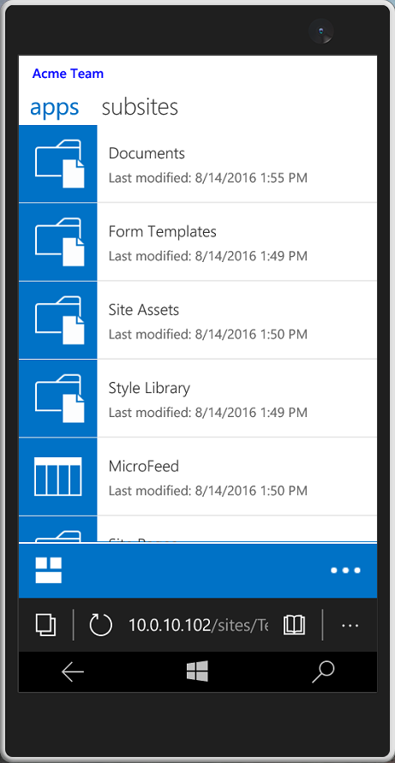
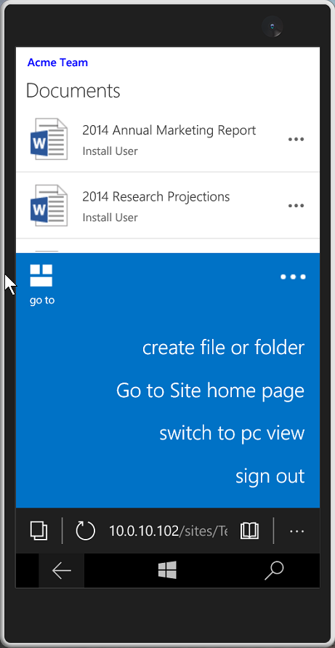
Collaboration - Mobile
New Native Mobile Interface
Document/Library Centric View
Touch Friendly
Toggle to PC View
Create Files or Folders
Open Document Format (ODF)
Use as Templates in Library
Facilitate Editing with Any Compliant editor

Slide 12
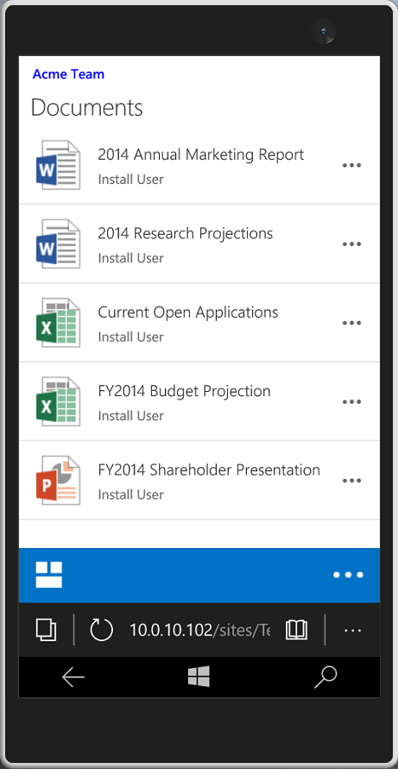

Slide 13
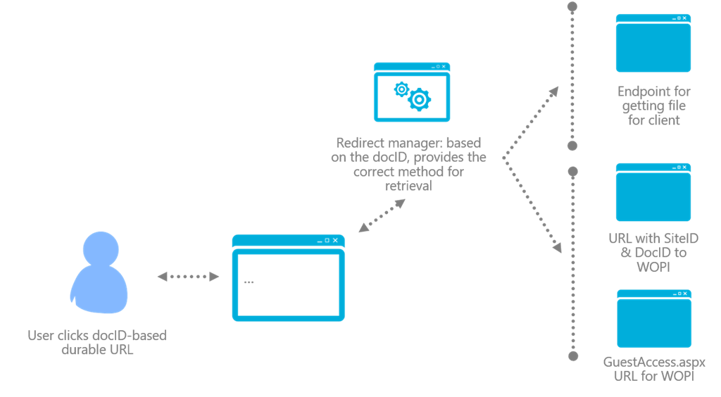
Collaboration – durable links
Requires Office Online Server
Limited to Site Collection
Permissions do not Follow
Activate Document ID Service Feature

Slide 14
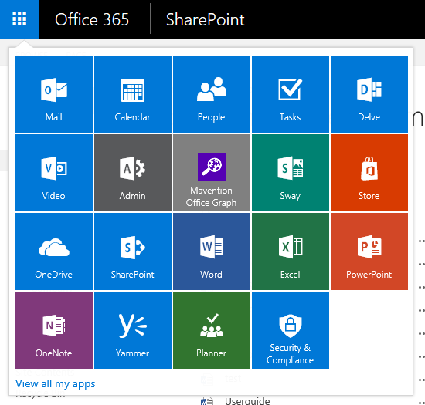
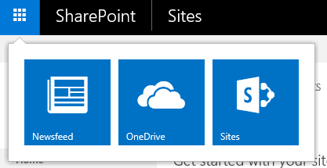
Collaboration – APP Launcher
Office 365
New Office 365 Type App Launcher
Improved User Experience in Hybrid when navigating between On-Premises and Online
SharePoint 2016

Slide 15
Improved Infrastructure and Performance

Slide 16
Infrastructure - Patching
Requires an HA Farm
MinRole isn’t required but will make this easier
Two Steps
Apply New Binaries (Apply binaries to one server while other carries load)
Upgrade Content Databases (Stored Procedure Improvements)
Stored Procs upgraded without being dropped
Stored Procs can be called by new or old binaries

Slide 17
Infrastructure – Increased Limits
SharePoint 2016 SharePoint 2013
Content Database Size | 1-2 TB | 200 GB in general usage scenarios.
Site Collections per Content Database | 100,000 site collections per content database | 2,000 recommended 5,000 max
List Threshold | Increased List Threshold >5,000 | 5,000 items
MaxFile Size | MaxFile Size increases to 10GB and removed character restrictions | Default maximum file size is 250 MB which can increase up to 2GB
Indexed Items | 2x increase in Search scale to 500 million items | 100 million per search service application. 10 million per index partition

Slide 18
Infrastructure – Fast Site Creation
Enable Template for use as Site Master
Create a Site Master in a Content Database
Create New Site collection using the Site Master
Enable-SPWebTemplateForSiteMaster –Template "STS#0" –CompatibilityLevel 15
$DB = Get-SPContentDatabase -site https://sp01.acmeman.com
New-SPSiteMaster -ContentDatabase $DB -Template "STS#0"
New-SPSite https://sp01.acmeman.com/sites/FastSite1 -ContentDatabase $DB ` -Template "STS#0" -CreateFromSiteMaster -CompatibilityLevel 15 ` -OwnerAlias "acmeman\sp_install"
Notes:
Enable-SPWebTemplateForSiteMaster –Template “STS#0” –CompatibilityLevel 15
$DB = Get-SPContentDatabase -site SiteUrl
New-SPSiteMaster -ContentDatabase $DB -Template “STS#0”
New-SPSite https://sp01.acmeman.com/sites/FastSite1 -ContentDatabase $DB -Template “STS#0” -CompatibilityLevel 15 -CreateFromSiteMaster -OwnerAlias “acmeman\sp_install”

Slide 19
Infrastructure - minrole
Six (6) predefined server
Base set of services deployed
MinRole can be chosen:
During the creation of a new server
By using Central Admin
Choose Custom role to manage individual services
Front End
Application
Search
Distributed Cache
Custom
Single Server Farm
Notes:
What is MinRole:
MinRole is the culmination of the past few years of analytics, performance and usage data taken from O365.
That data was then basically transformed into an on premises farm topology that simplifies administration and boosts performance.
Essentially SharePoint Server 2016 is designed on the same base as O365 and thusly is the most tested version of SharePoint Server ever released.
How does MinRole Work:
When you create a new farm or join a machine to an existing farm, SharePoint starts a base set of service instances that are required for the server’s role.
It also detects the running services and services applications in the farm and starts the appropriate services and endpoints on the server based on its role.
As you enable or disable services in the farm, or as you create and delete service applications in the farm, MinRole starts and stops service instances on the existing servers in the farm.
Role Types Explained:
Front-End
Service applications, services, and components that serve user requests.
These servers are optimized for low latency.
In the past Front end servers were designed from a services perspective to be streamlined in order to free up resources to serve users requests and to relay content.
Now new logic has been built in to service requests from the local server instance of service applications instead of reaching out across the farm to the traditional application servers.
These local service application endpoints can be configured to serve content to users instead of pulling the data from other servers revealing the shortest path possible for the retrieval of content.
Another idea behind this architecture is to streamline and limit the inter-server traffic.
App
Service applications, services, and components that serve backend requests (such as background jobs or search crawl requests) belong on Application servers. These servers are optimized for high throughput.
Microsoft uses the term “Application” differently than it has in the past when talking about the application server role.
In the past this server has been used to run service application end-points.
Now this server role is still designed to handle the heavier loads of search crawl and query etc.
Distributed Cache
Service applications, services, and components that are required for a distributed cache belong on Distributed Cache servers.
Search
Service applications, services, and components that are required for searching belong on Search servers.
Custom
Custom service applications, services, and components that do not integrate with MinRole belong on Custom servers. The farm administrator has full control over which service instances can run on servers assigned to the Custom role. MinRole does not control which service instances are provisioned on this role.
SharePoint Server 2016 supports the backward compatible behavior of previous SharePoint releases with the Custom role.
SharePoint farm administrators can directly manage service instances on individual servers assigned to the Custom role.
You can assign zero, some, or all servers in a farm to the Custom role.
If you have existing deployment scripts that you do not want to modify to support MinRole, you can specify the ServerRoleOptional parameter when you create a new SharePoint farm by using the PSConfig.exe command-line tool or Windows PowerShell. This parameter configures the farm to not require a server role to be specified. If no server role is specified, the server defaults to the Custom role.
Single Server Farm
Service applications, services, and components required for a single machine farm belong on a Single-Server Farm. A Single-Server Farm is meant for development, testing, and very limited production use. A SharePoint farm with the Single-Server Farm role cannot have more than one SharePoint server in the farm.

Slide 20
Infrastructure - minrole
Role Name | Description
Front End | Services end user requests, optimized for low latency.
Search | Reserved for Search services.
Application | Services the backend jobs or the requests triggered by backend jobs, optimized for high throughput.
Distributed Cache | Services distributed cache for the farm. Optionally, the server assigned to this role can load balance end user requests among the web front ends.
Custom | Reserved for services to be isolated from other services, I.e. 3rd party, PerformancePoint, etc.
Single Server Farm | Provisions all services on the server for a single server deployment. This role is provided for evaluation and development purposes.
Note: New Combinations available post Feature Pack I

Slide 21
Better Hybrid Support

Slide 22
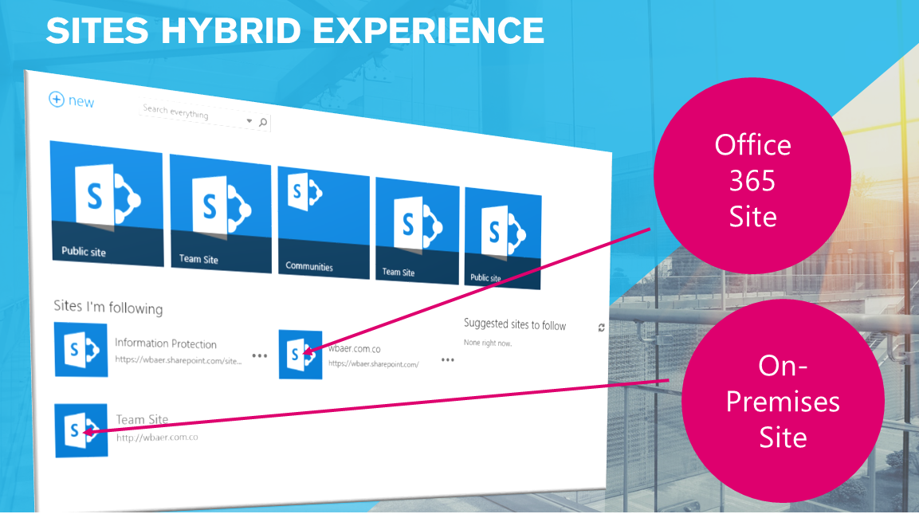
Hybrid - Sites
All new Followed Sites are added to O365
Sites link on-premises is redirected to Office 365
Sites tile in the on-premises app launcher is redirected to Office 365
Note: Existing On-Premises Followed Sites are not Migrated
Notes:
When you enable hybrid site following:
The Sites link in a SharePoint Server site is redirected to Office 365 (SharePoint Server 2013).
The Sites tile in the app launcher Office 365 app launcher icon is redirected to Office 365 (SharePoint Server 2016).
When a user follows a site in SharePoint Server, it is added to the followed list in both SharePoint Server and Office 365.
NOTE
The SharePoint newsfeed functionality, followed documents, and followed people are unaffected by this and will remain on premises only.
NOTE
that existing followed sites lists in SharePoint Server are not migrated to Office 365 when you turn this feature on (though any sites in the Office 365 list will remain there).
Users will have to follow their SharePoint Server sites again once the feature is turned on.
The WHY?
A single or consolidated location for user profiles, mysite content and site following eases the user population into the cloud while still keeping business crital portions of content on prem.
Allows admins to allow users to get the most out the mysite/OneDrive functionality but do not have to worry about the storage, back up/retention of user data.
Could help to eliminate on prem file share personal drives altogether.
Possibly reduce VPN usage for personal data from users on the road or from home.

Slide 23
Hybrid - ONeDrive
OneDrive link in the App Launcher is redirected to OneDrive for Business in O365
About Me link in Welcome menu is redirected to OneDrive for Business
User Profile links are redirected to Delve in O365
Note: O365 User Profiles are still evolving! No Custom User Profile Property Sync
Notes:
NOTE:
Because there's no direct link between OneDrive for Business in SharePoint Server and OneDrive for Business in Office 365, users' Shared with me lists in Office 365 won't display documents that have been shared with them from on-premises SharePoint Server
During a SharePoint Server 2016 Webinar with Bill Baer he shared that now the OneDrive link in the suite bar can be audience to direct certain users to the cloud and other can directed to their OneDrives on Prem
WHY?
USERS:
Store personal files they are working on in the cloud, and access these files even when they aren’t signed in to your corporate network.
Access these files on devices such as iPhones, Windows Phones, tablets, and so on.
Share and collaborate on documents with others in your organization or with external users by using guest links.
IT PROS:
Provide cloud storage for your users.
Limit the need for storage on premises.
Everyone has a personal drive and with those personal drives comes all the required hardware, storage, back up time and space.
Control and administer storage for your users in the cloud in 25–100 gigabytes (GB) increments, as needed.
Continue to provide SharePoint features as usual in your on-premises farm.

Slide 24
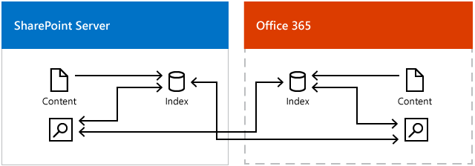
Hybrid – Cloud Search Service
On-premise Search Service sends index to Cloud
Support for Office Graph / Delve inclusion of on-premises content
Search Queries return a single unified results set

Slide 25
Hybrid Managed Metadata
Requirements
SharePoint Server 2013 - November 2016 public update
SharePoint Server 2016 - November 2016 public update (Feature Pack 1)
Migrate Termsets to Office 365 using Copy-SPTaxonomyGroups
$credential = Get-Credential
Copy-SPTaxonomyGroups –LocalTermStoreName "MMServiceApplication" -LocalSiteUrl "OnPremisesSiteURL" -RemoteSiteUrl "http://SharePointOnlineSiteURL" -GroupNames "Group1","Group2" -Credential $credential
a

Slide 26
Hybrid Managed Metadata – cont.
Configure Hybrid Taxonomy
Log on to on-premises SharePoint Server as a farm administrator
On Server - log on to Office 365 as a global administrator
In the SharePoint Online Admin Center > configure hybrid.
On the hybrid picker page > Hybrid Picker.
Follow the wizard and choose Hybrid Taxonomy when prompted.
Note: On-premises Timer Service Account must be Term Store Admin

Slide 27
Feature Pack 1

Slide 28
Feature Pack 1
Released November 8, 2016
Enhancements
Administrative action logging
MinRole enhancements for smaller environments
New OneDrive for Business user experience for on-premises
SharePoint app launcher with custom tiles (Hybrid)
Unified auditing across site collections (Hybrid)
Unified taxonomy (Hybrid)
OneDrive API 2.0.

Slide 29
Other Talks at SharePoint Fest
BI 201 - What's new for the BI workload in SharePoint 2016 – John White, MVP
BV 104 - What do YOU get from SharePoint Hybrid? - Vlad Catrinescu, MVP
BV 204 - Extranets in SharePoint On Premises and Office 365 – Peter Carson, MVP
ECM 104 - Protecting your Content: Demystifying Data Loss Prevention (DLP) in SharePoint – Paul Stork, MVP
OFF 103 - The ultimate guide about SharePoint and Office365: “what’s new” from A to Z - Gokan Ozcifci, MVP
SRC 104 - SharePoint 2016 Search - Mike Maadarani, MVP

Slide 30
Additional resources
Future of SharePoint Videos https://www.youtube.com/playlist?list=PLXtHYVsvn_b-gqw2KcW0vzRyHRjnOtY-6
New and improved features in SharePoint Server 2016 https://technet.microsoft.com/en-us/library/mt346121(v=office.16).aspx
Install a software update for SharePoint Server 2016 https://technet.microsoft.com/en-us/library/ff806338(v=office.16).aspx
Video demo of Zero Downtime Patching in SharePoint Server 2016 https://technet.microsoft.com/en-us/library/mt767550(v=office.16).aspx

Slide 31
Surveys
Learn from the Top SharePoint Experts
Feedback Please!
Session Surveys via Event App
Select “Schedule” -> Select Session -> Scroll to “Session Survey”
Download the App:
Event URL https://crowd.cc/spfdc17
Your App URL https://crowd.cc/s/zN7K
Or search for “SharePoint Fest” in App Store
SharePoint Fest
DC 2017

Slide 32
Questions?
Contact Information
Email: Paul.Stork@bluechip-llc.com
Blog: http://dontPaPanic.com/blog
Twitter: @PStork

